Slide 1
PS Project
Eeshita Gupta (B231)
Pratyush Medimi (B229)

Slide 2
IMDB MOVIES Analysis
Problem Statement:
To transform, clean, summarize, extract, explore and visulaize the imdb data set on top 1000 movies from the year(1980- 2015). These above mentioned process are done using runtime , ratings and meta score columns of imdb movie database.
Processes Used:
Data Cleaning and Transformation
Summary And Head operation on Dataset
Data Extraction
Data filter
Data Exploration and Visualization

Slide 3
Dataset Description & Software Tool Used:
Dataset Description:
Series_Title = Name of the movie
Released_Year - Year at which that movie released
Certificate - Certificate earned by that movie
Runtime - Total runtime of the movie
Genre - Genre of the movie
IMDB_Rating - Rating of the movie at IMDB site
Overview - mini story/ summary
Meta_score - Score earned by the movie
Director - Name of the Director
Star1,Star2,Star3,Star4 - Name of the Stars
Noofvotes - Total number of votes
Gross - Money earned by that movie
Software Tool Used:
R studios

Slide 4
Process:
I chose the data set from (Kaggle): IMDB TOP 1000 MOVIES.
Then recognized the business problem.
Using R studios I found out the mean,median, mode and standered diviation of my data set.
Data cleaning:
Found Max time,meta score, ratings.
Found Minimum time, rating,meta score.
Performed Summary And Head operation on Dataset.
5. Data Extraction:
Extract 5 Columns of dataset using (Select Function).
Extract the first 7 columns from datasets.
6. Data filter:
Filter the genre which is Drama.
Filter the runtime greater than 150.
Filter the the ratings less than 8.0.
7. Data Exploration and Visualization:
Plot A graph for runtime, imdb rating and meta score

Slide 5
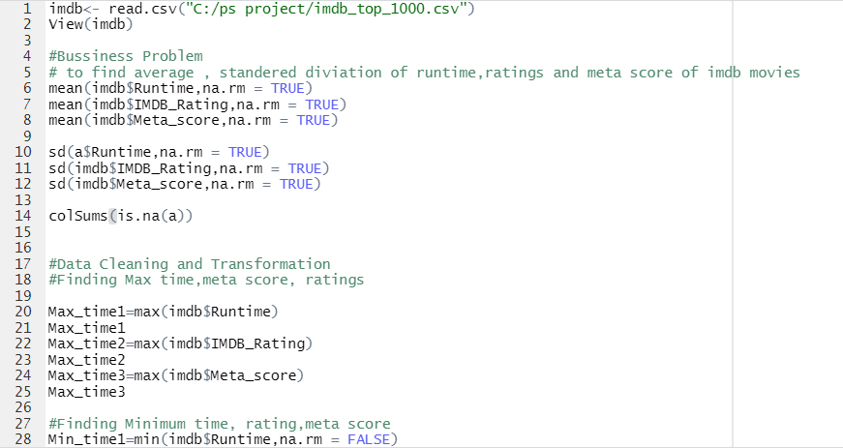
Code

Slide 6
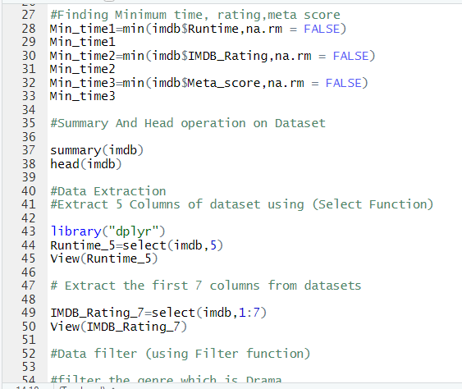

Slide 7
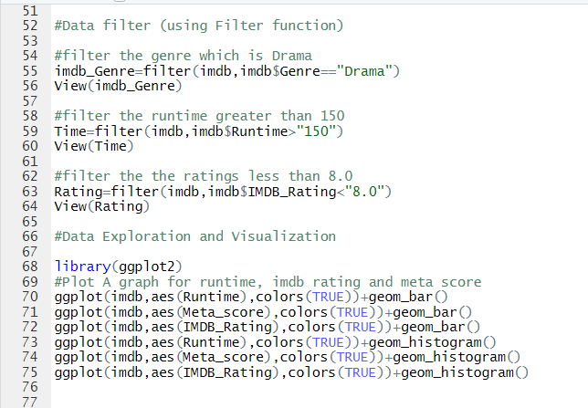

Slide 8
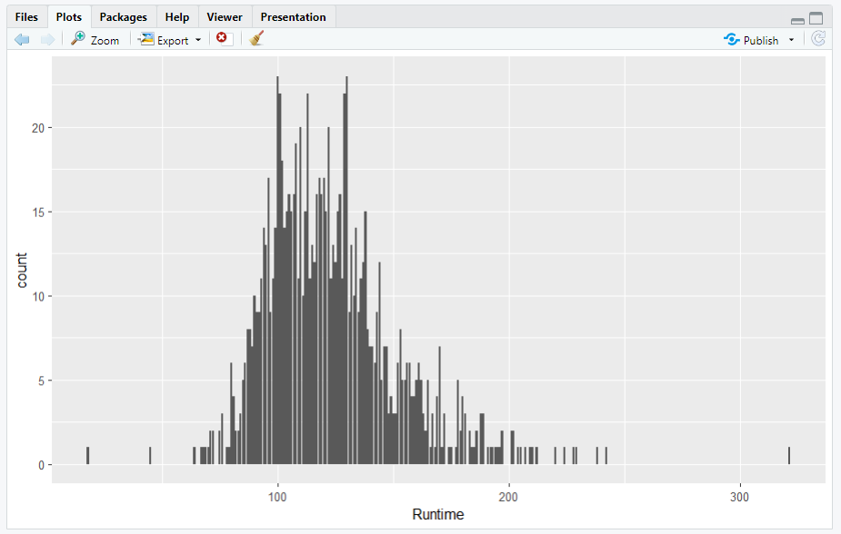
Analysis

Slide 9
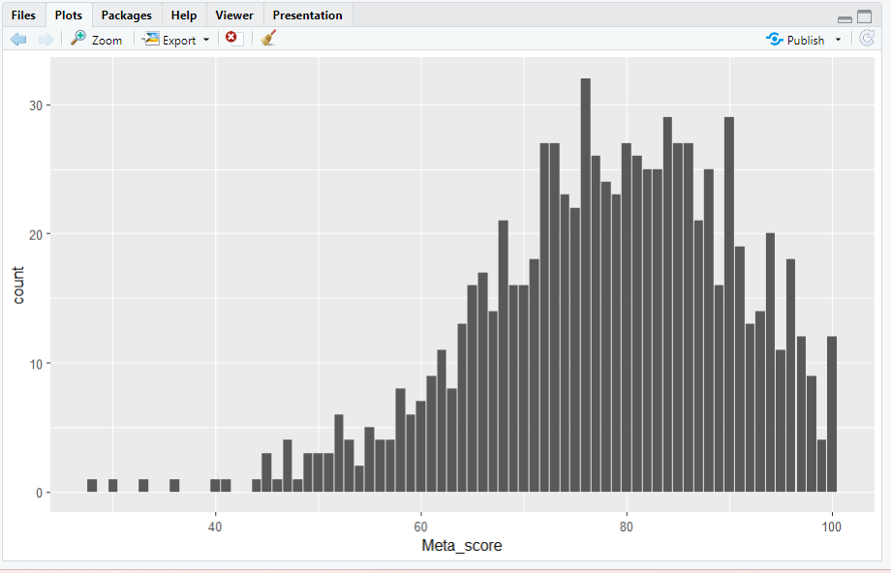

Slide 10
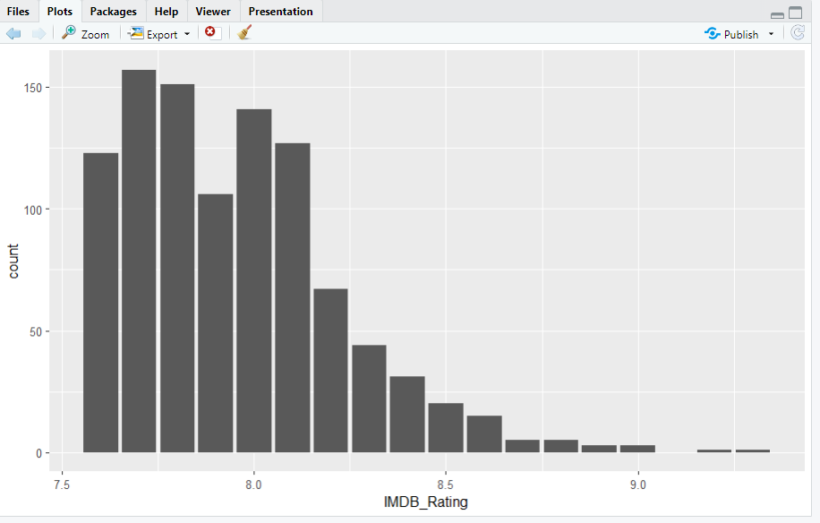

Slide 12
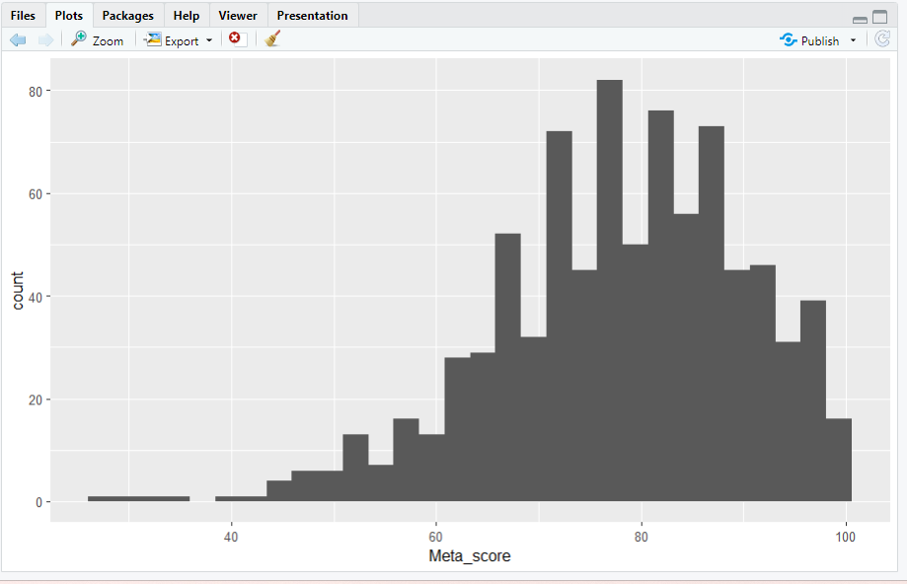

Slide 13
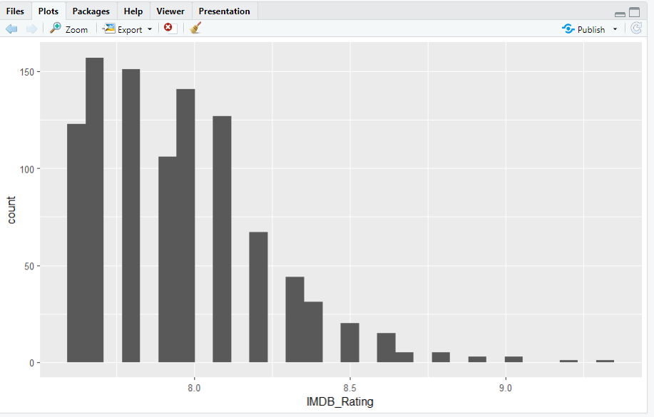

Slide 14
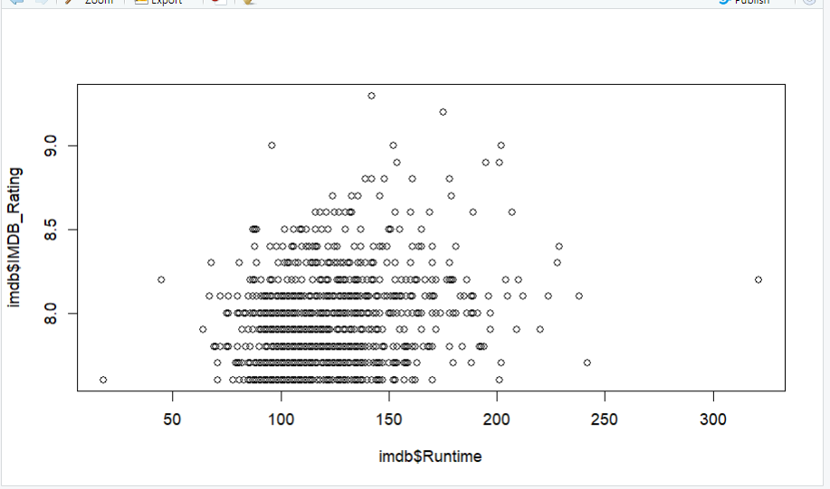

plot(imdb$Runtime,imdb$IMDB_Rating) cor(imdb$Runtime,imdb$IMDB_Rating)

Slide 15
Conclusion & Reference
Transform, clean, summarize, extract, explore and visulaize the imdb data set on top 1000 movies from the year(1980- 2015). These above mentioned process are done using runtime , ratings and meta score columns of imdb movie database.
Reference:
https://www.kaggle.com/datasets/harshitshankhdhar/imdb-dataset-of-top-1000-movies-and-tv-shows

Slide 16
THANK YOU!!

